Slide 1
Testasp.vulnweb.com
Summary :
Testasp.vulnweb.com website https://www.testasp.vulnweb.com has an endpoint that is vulnerable to an injection vulnerability - namely a reflected injection of JavaScript, also known as Reflected Cross Site Scripting (XSS). As per OWASP's definition: "Cross-Site Scripting (XSS) attacks are a type of injection, in which malicious scripts are injected into trusted websites. " This happens because one of the GET parameters "p" does not properly sanitize/escape user input, allowing an injection to occur.

Slide 2
Steps to reproduce :
To reproduce this, an attacker has to:
Prepare a Javascript payload that it wants the victim to execute. In this case, for Proof of Concept purposes, our Javascript code will prompt an alert .
Here we have just used two codes for demonstration -
<script>alert(1)</script>
<body onfocus=alert(1)>
Inject this Javascript code properly into the vulnerable parameter, creating thus a crafted future GET request that will inject the payload.
As this injection happens in a GET parameter, the attacker simply needs to send the crafted Link that produces this GET request to the victim and have the victim click it.

Slide 3
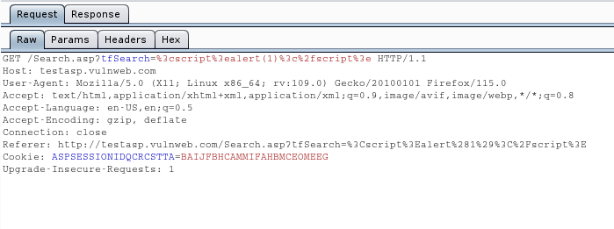
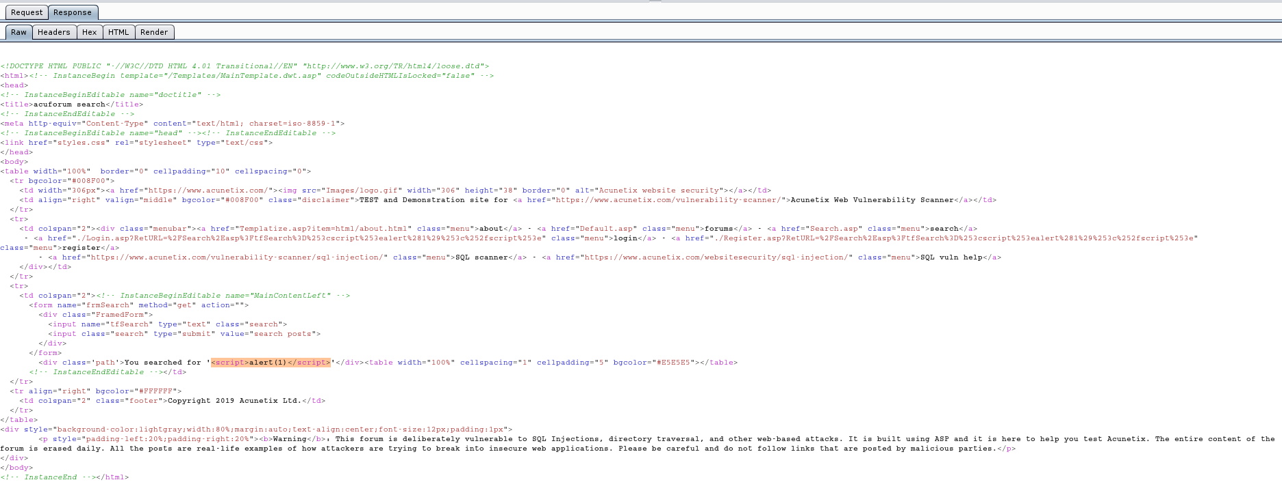

Request PoC :-

Slide 4
Impact :
With user interaction, an attacker could execute arbitrary Javascript code in a victim's browser. This would allow an attacker to unwillingly make a victim :-
Perform any action in the identified endpoint
View any information that the user is able to view
Modify any information that the user is able to modify (not sure if applicable in this case)
Interact with other application users as if it were him - impersonation (not sure if applicable in this case)

Slide 5
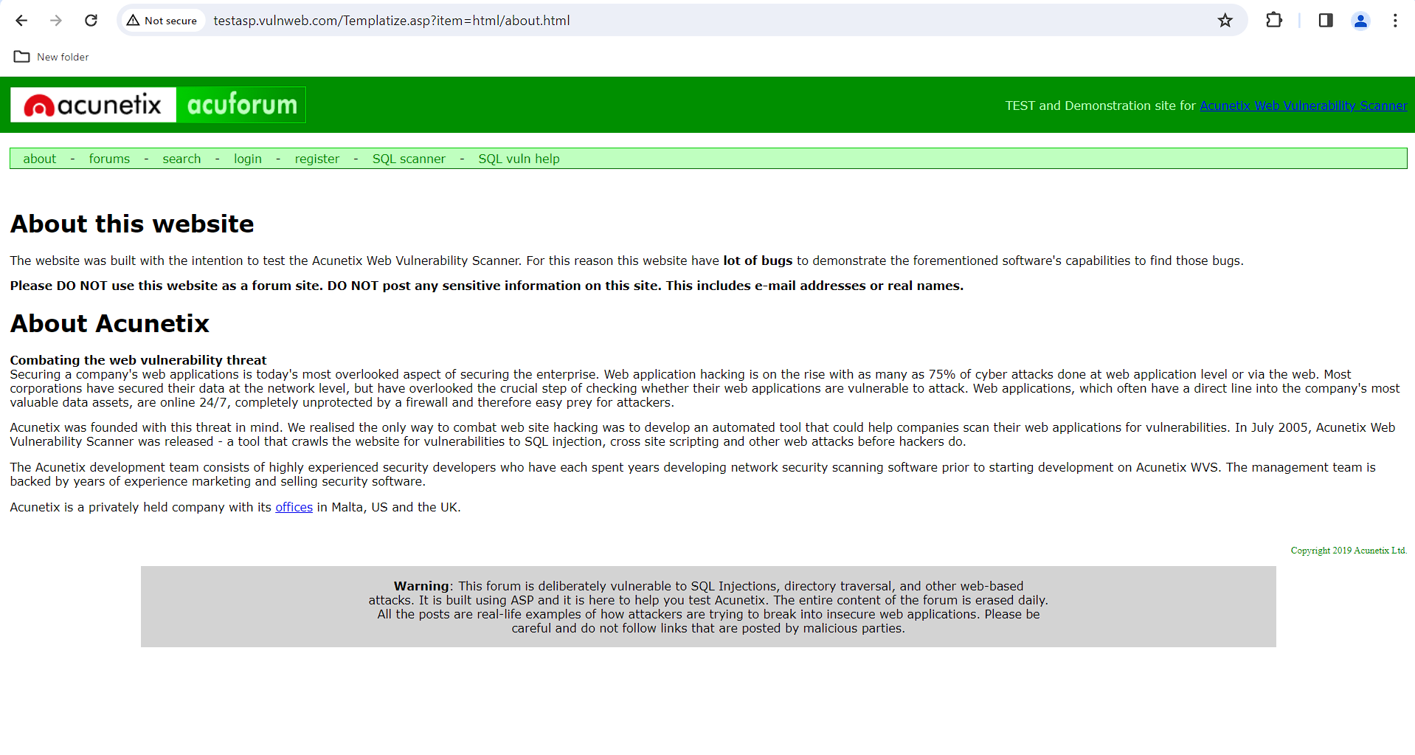
Screenshots :-

Slide 6
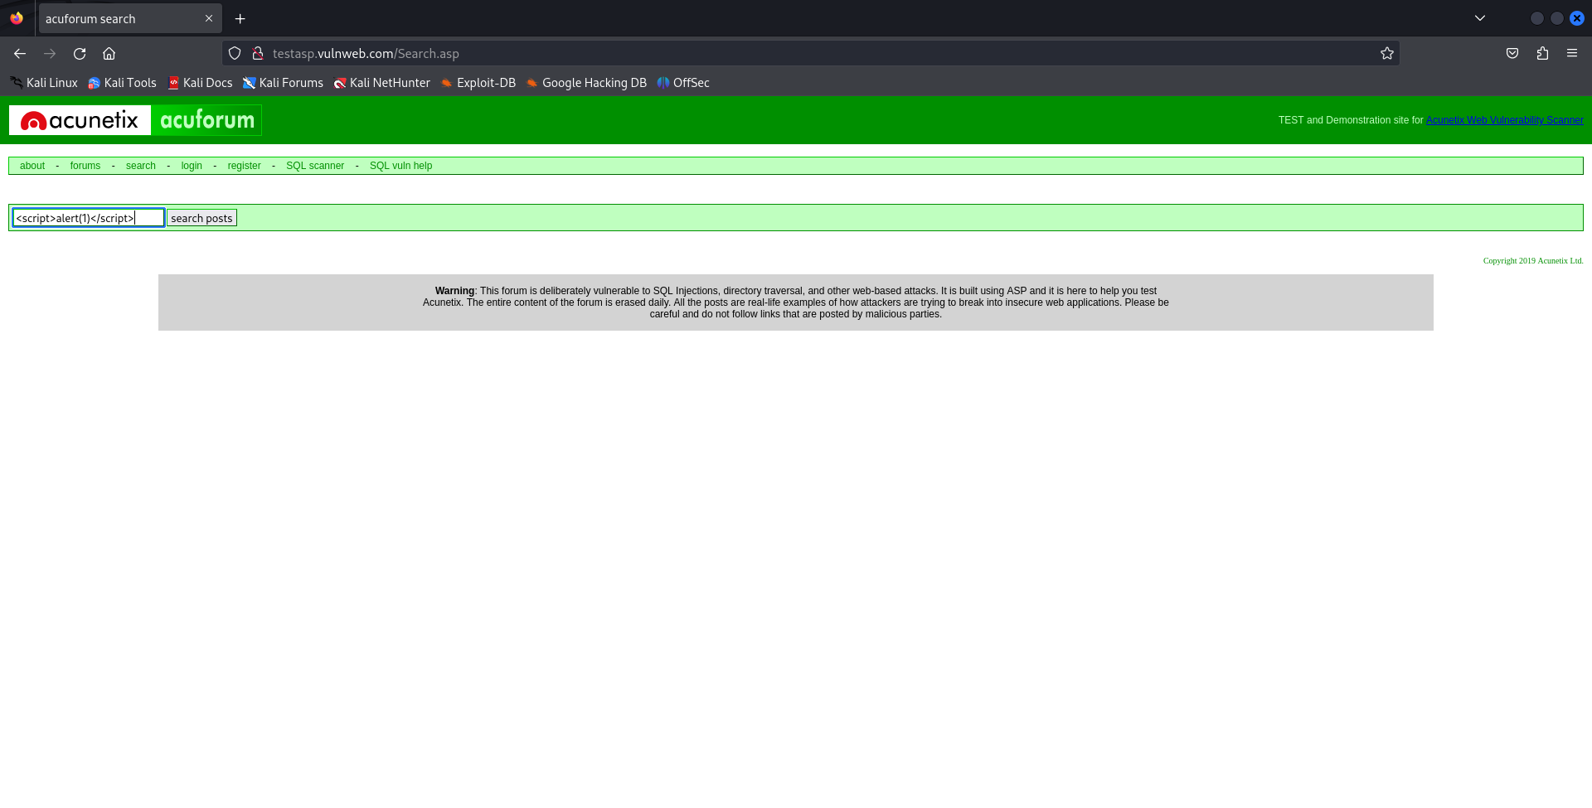
Vulnerability 1 :-

Slide 7
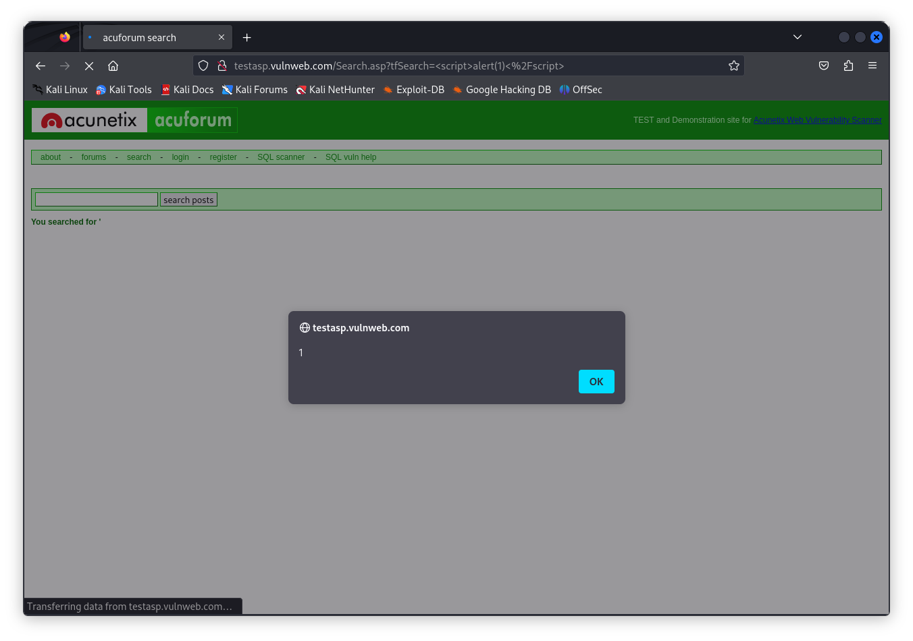

Slide 8
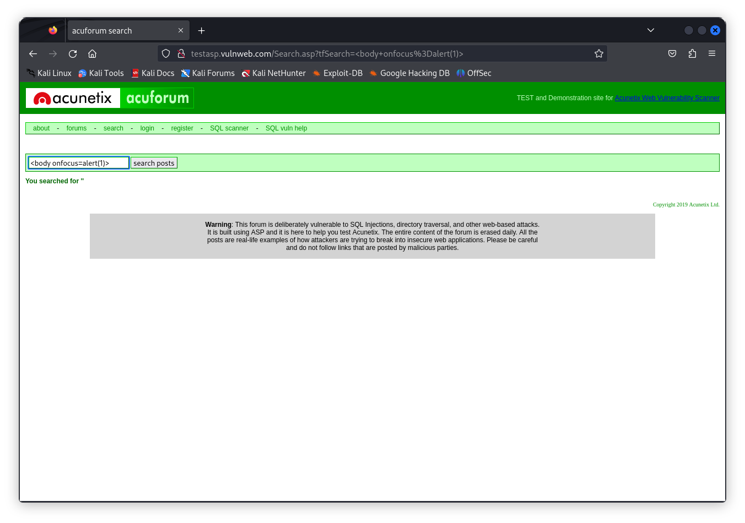
Vulnerability 2 :-

Slide 9
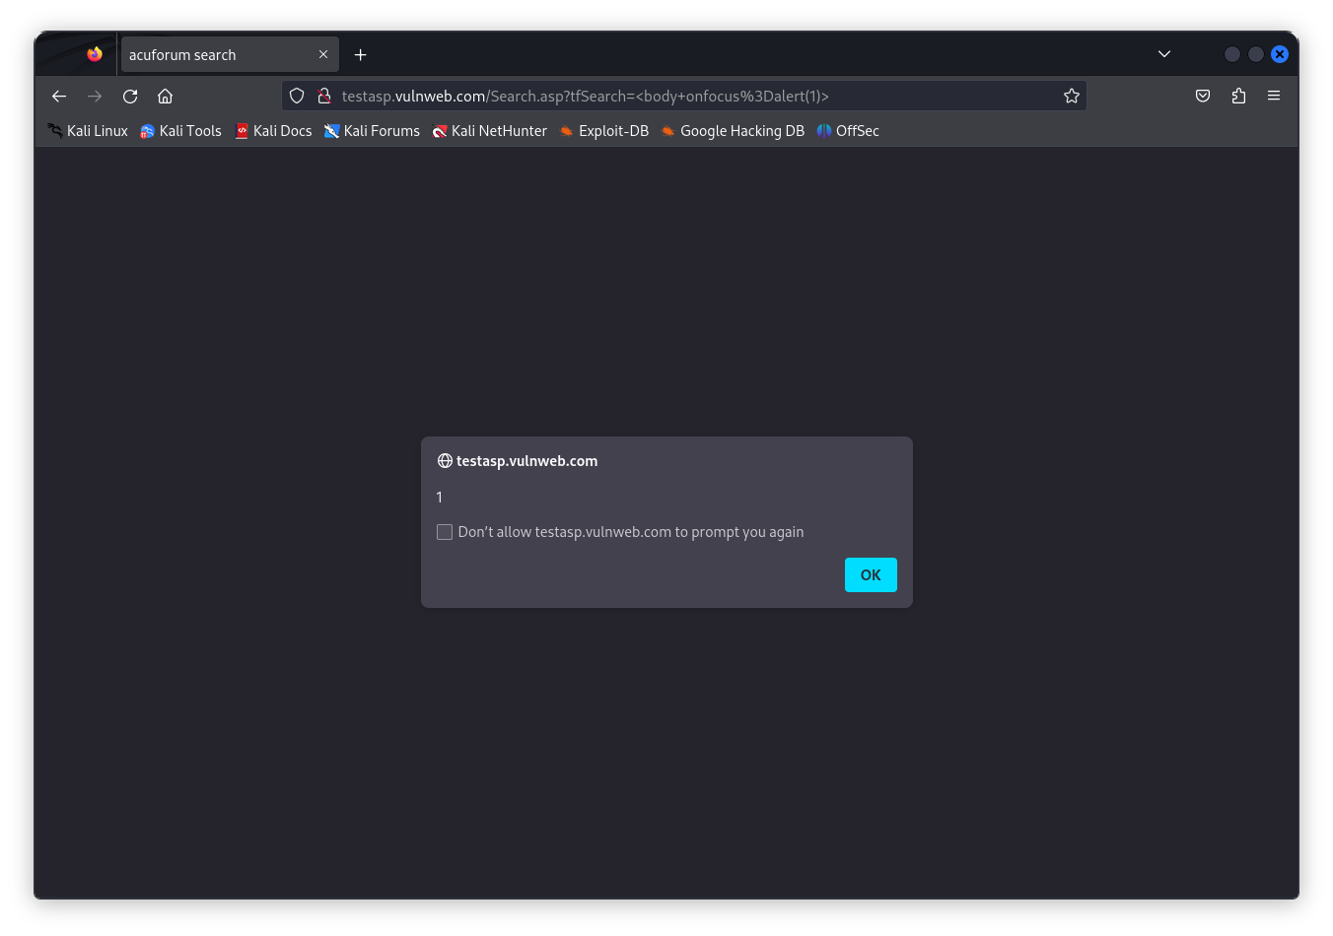

Slide 10
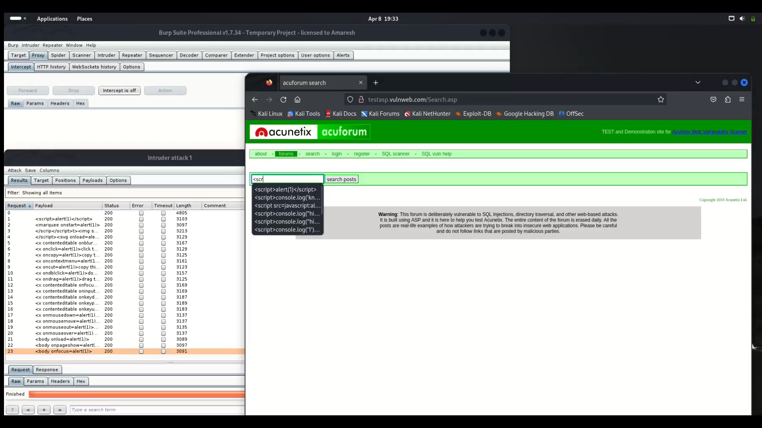
Video :-

